Slide 1
Demand and Supply
Professor Ravi Kiran

Slide 2
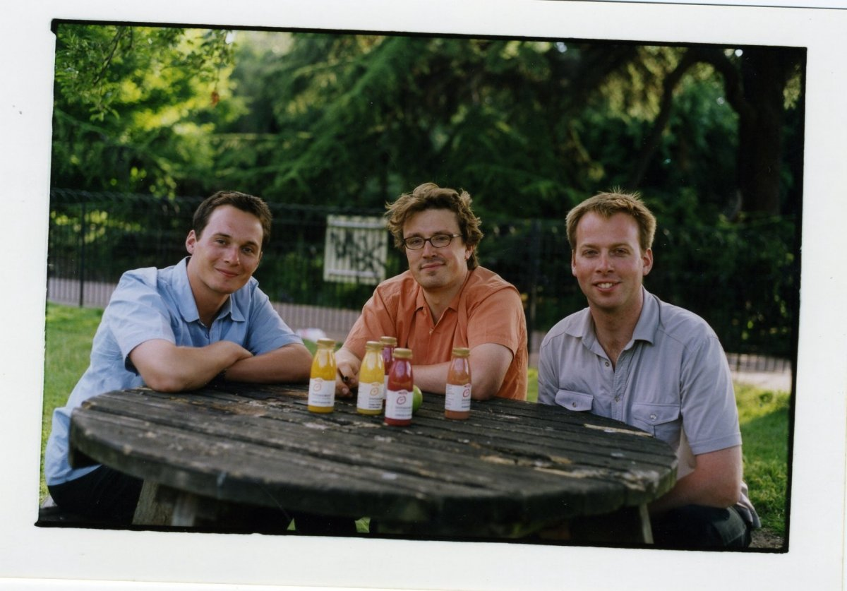

Richard Reed, Adam Balon and Jon Wright started innocent in 1999 after selling their smoothies at a music festival.
Innocent Drinks is a company that makes smoothies and juice sold in supermarkets, coffee shops and various other outlets. The company sells more than two million smoothies per week. Innocent is over 90% owned by The Coca-Cola Company.
Richard Reed, Adam Balon and Jon Wright
Cambridge University graduates

Slide 3
Do you think we should give up our day jobs to make these smoothies?
They put up a big sign asking people if they thought that Richard, Adam and Jon should give up their jobs to make smoothies, and put a bin saying 'Yes' and a bin saying 'No" in front of the stall.
They requested people to vote with their empties. At the end of the weekend, the 'Yes' bin was full, so they resigned from their jobs the next day.
Since then they started making smoothies and juices as natural, delicious, healthy drinks.
The Coca-Cola Company(90%)

Slide 4
Supply
Supply
Stock

Slide 5
Supply
The law of supply states that, all other factors being equal, as the price of a good or service increases, the quantity of goods or service that suppliers offer will increase and vice versa.
Ceteris Paribus there is a direct relation between price and quantity supplied.

Slide 6
Law of Supply
S₀
P₁
P₀
P₂
Q₂
Q₀
Q₁

Slide 7
Factors Influencing Supply
Cost of Factors of Production
Technology
Expectations
of
Producers
Number
of
Producers
Subsidy
Productivity
Taxes

Slide 8
 | Cost to Production | Amount of Quantity Supplied | Supply Curve Shifts
Cost of Factors of Production Falls |  |  | Supply Increases
Cost of Factors of Production Rises |  |  | Supply Decreases
Productivity Decreases
Productivity Increases
New Technology
Higher Taxes
Lower Taxes
Government Subsidy

Slide 9
Suggested Readings
Samuelson, Paul A.; Nordhaus, William D.; Chaudhuri, Sudip; Sen, Anindya (2019). Economics. McGraw-Hill.

Slide 10

Thank You

